Slide 1
GREATER OMAHA SPORTS COMMITTEE
Winter Scholar Athlete Award Winners 2024
Hilton Omaha, Downtown
1001 Cass St
Sponsored by Playsmart

Slide 2


Slide 3
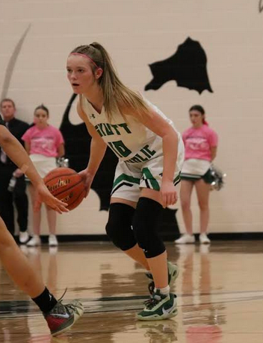

Peyton McCabe
Selected for Outstanding Scholarship and Achievement in the Sport of Basketball
Academics: GPA - 3.96
9th Grade: Qualified for State, First Team All Conference
10th Grade: Class B State Runner-Up, Broke school record for points in a game, First Team All Conference
11 Grade: Class B State Runner-Up, NE All Class Second Team, NE Class B First Team, broke 1,000 career points, broke school record for most career points
12 Grade: Class B State Runner-Up, 3rd All Time NE HS basketball for made 3-pointers in a career, signed to Drake University

Slide 4


Slide 5
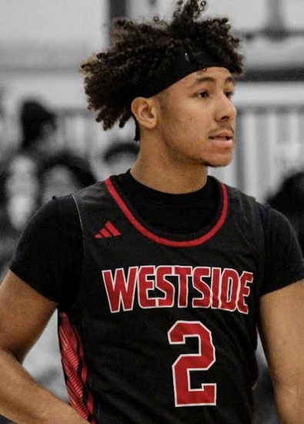

Caleb Benning
Selected for Outstanding Scholarship and Achievement in the Sport of Basketball
Academics: GPA - 3.77 Rank: 162/547
10th Grade: All State, All Metro, All Nebraska
11 Grade: All State, All Metro, All Nebraska
12 Grade: All State Captain, All Metro, All Nebraska

Slide 6
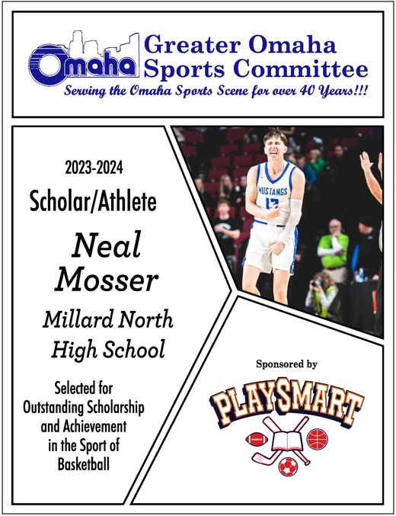

Slide 7
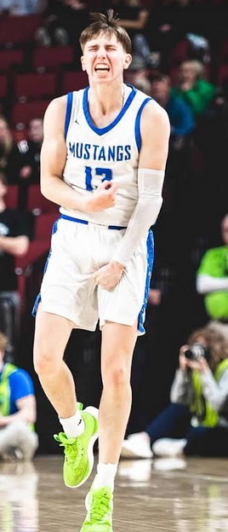

Neal Mosser
Selected for Outstanding Scholarship and Achievement in the Sport of Basketball
Academics: GPA -3.7
10th Grade: State Championship, School record - 3pts made in a game (7)
11 Grade: Team Captain, State Runner-Up, school record - free throw % in a season (90.9%), Basketball Leadership Council, All Metro 3rd Team, All Class State Tournament Team, Class A State Tournament Team, only Class A 50/40/90 shooter
12 Grade: school record - 3pt made career @ 195+, WOWT Athlete of the Week, Team Captain

Slide 8
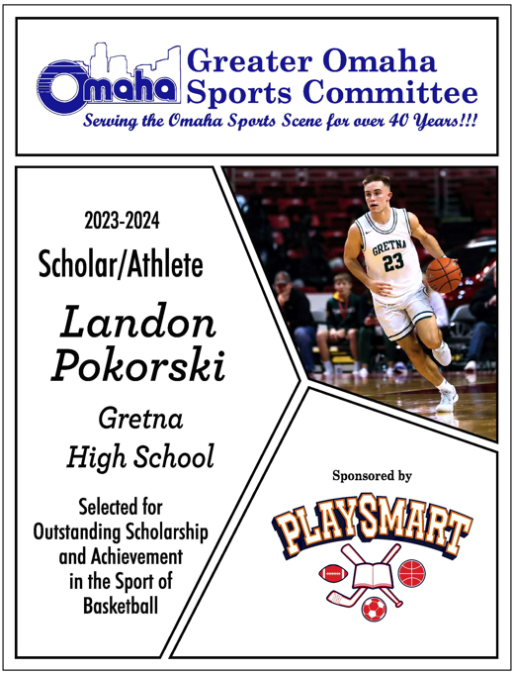

Slide 9
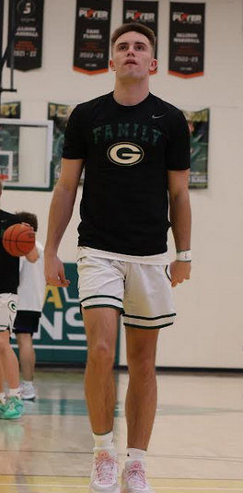

Landon Pokorski
Selected for Outstanding Scholarship and Achievement in the Sport of Basketball
Academics: GPA - 3.0
10th Grade: 2nd Team Super State, 3rd Team All Nebraska, 2nd Team All Metro
11 Grade: 1st Team All Nebraska, 1st Team Super State, 1st Tea, All Metro, State Semi-Finalist, 1,000 points surpassed, 1st Team State Tournament
12 Grade: KETV Athlete of the Week, Gretna All Time Leading Scorer + All Time Assist Leader (other awards
not announced)

Slide 10
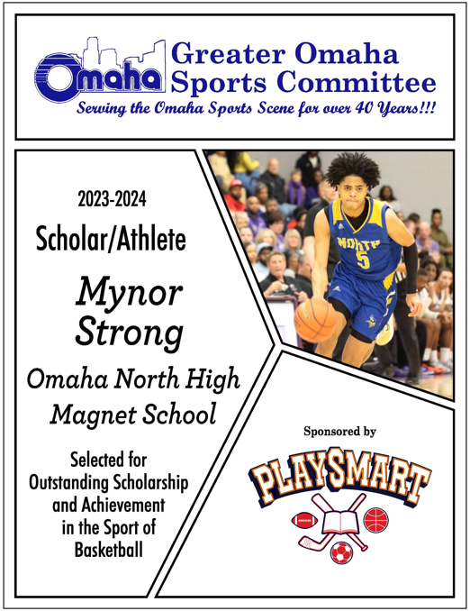

Slide 11
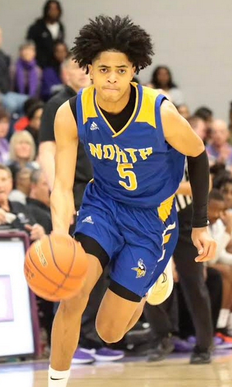

Mynor Strong
Selected for Outstanding Scholarship and Achievement in the Sport of Basketball
Academics: GPA -3.39 Rank - 46/379
10th Grade: Academic All-State Varsity Basketball
11 Grade: Varsity Starter, led the team in steals, 2nd place on team for scoring
12 Grade: Varsity starter, Team Captain, led the team in scoring, #3 in state scoring, led team in assists, Top 10 in state for assists, led team in steals, Top #1 in state for
steals, 2023 District Champions, State Qualifier

Slide 12
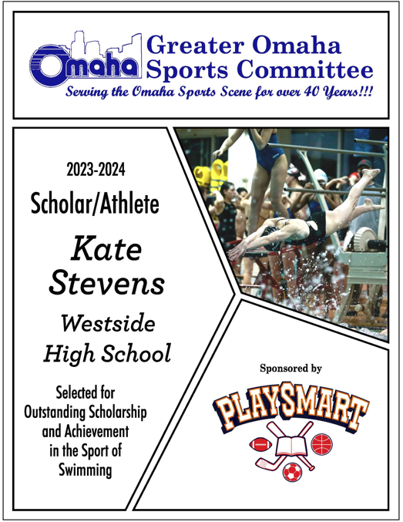

Slide 13
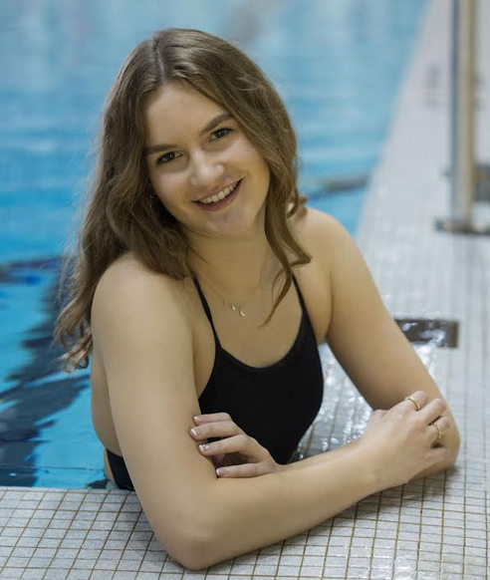
Kate Stevens
Selected for Outstanding Scholarship and Achievement in the Sport of Swimming
Academics: GPA - 3.99
11 Grade: Individual State Champion, Team State Champion, 3x School records, NISCA All-american, Metro Conference All-American, All Academic, NCPA Academic All-State, Metro Conference Individual + Team Champion
12 Grade: Relay State Champion, Team State Champion, rebroke 2 school relay records, NISCA All- american, Metro Conference All-American, 3x Metro Champion +
new meet record, Team Co-Captain

Slide 14
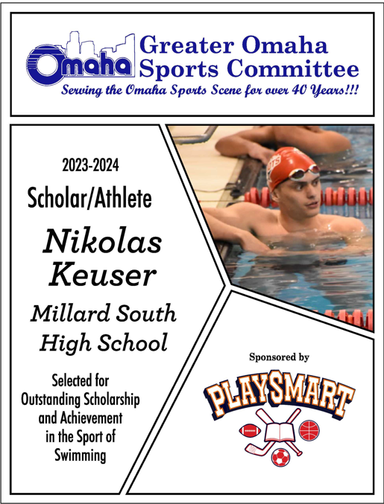

Slide 15
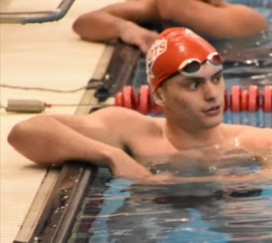

Nikolas Keuser
Selected for Outstanding Scholarship and Achievement in the Sport of Swimming
Academics: GPA - 3.56
10th Grade: Metro Finalist + 50 free Champion, State Qualifier + Top 3 Finalist, 100 Breast School Record, 100 Breast All-American, 100 Breast Jr. Nationals Qualifier + Finalist
11th Grade: Metro Finalist, State Qualifier + Top 3 Finalist, 100 Breast School Record, 100 Breast All-American, 100 Breast Jr. Nationals Qualifier + Finalist
12 Grade: Metro Champion, State Champion 100 Breast, Runner-up in 50 Free, 100 Breast School Record, 50 Free Record, 100 Breast All-American, 100 Breast Jr. Nationals Qualifier + Finalist

Slide 16
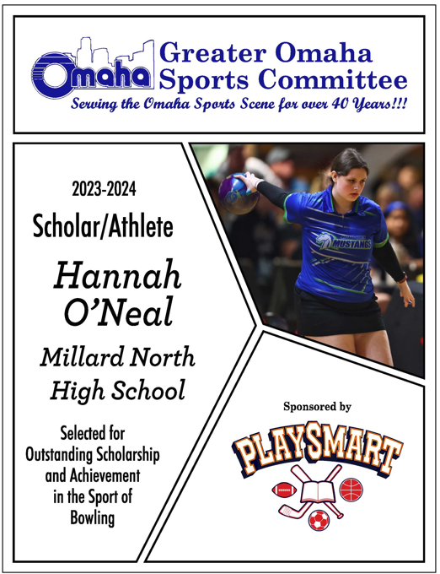

Slide 17
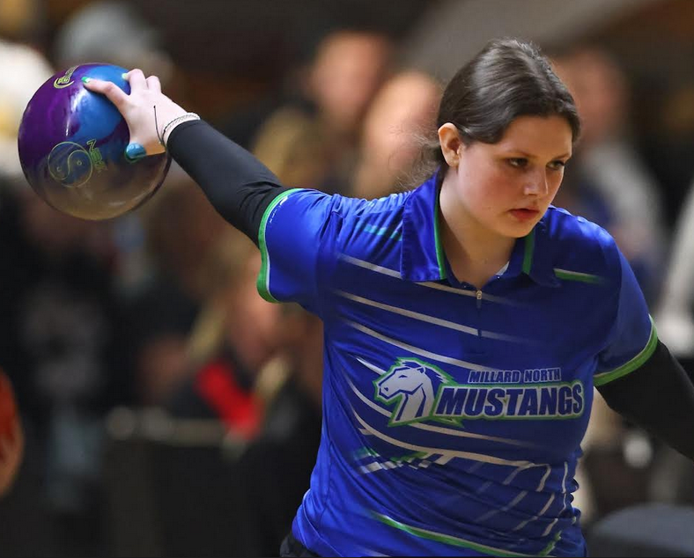
Hannah O’Neal
Selected for Outstanding Scholarship and Achievement in the Sport of Bowling
Academics: GPA - 4.0
10th Grade: Varsity Letter
11 Grade: Varsity Letter, Captain, All Tournament team for Millard North NCPA Academic All-State Award, 4th place at Districts, State Qualifier
12 Grade: Varsity Letter, Captain, All Tournament team for Millard North NCPA Academic All-State Award, 4th at Metros, 3rd at Districts, 8th at State, School Record – 192 score.

Slide 18


Slide 19
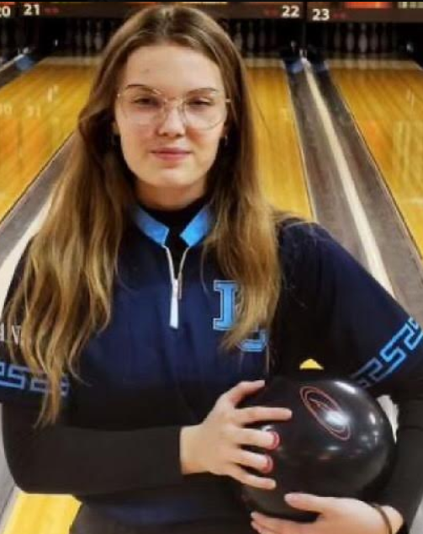

Faith Renshaw
Selected for Outstanding Scholarship and Achievement in the Sport of Bowling
Academics: GPA - 4.0
10th Grade: Team State Champion, 6th place State individual, 2nd Team All District
11 Grade: Co-Captain, Team State Champion, State Individual qualifier , LC Girls High Game
12 Grade: Captain, 4th Place Team State, 5th place Individual, 1st Team all district, 1st Team All State, KMA Al-State girls 2A Team, KMA girls All Senior Team

Slide 20
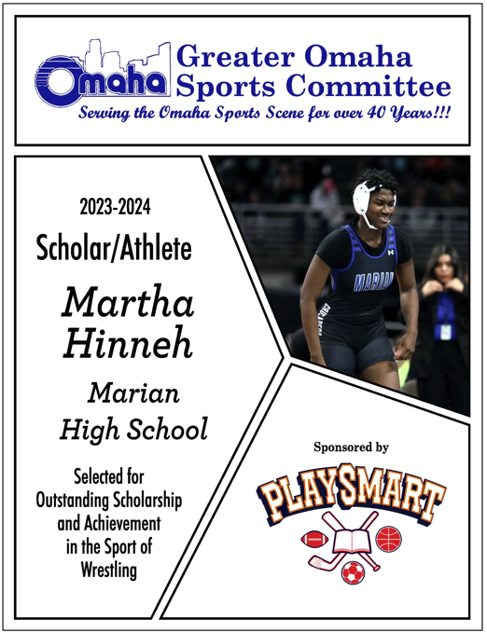

Slide 21
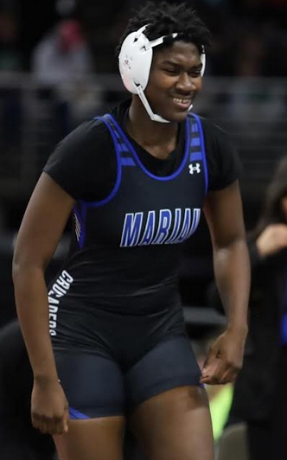

Martha Hinneh
Selected for Outstanding Scholarship and Achievement in the Sport of Wrestling
Academics: GPA - 3.52
10th Grade: Omaha Metro Girl of the Week, 4th at Districts, Metro Champion
11 Grade: 3rd at NSAA State, 2nd at NSAA Districts, 1st at Metros, 2nd Southern Plains Regionals
12 Grade: 3rd at Council Bluffs Classic, 2nd at Metros, Omaha Metro Girl of the Week, 1st at NSAA Districts, NSAA State Champion

Slide 22


Slide 23
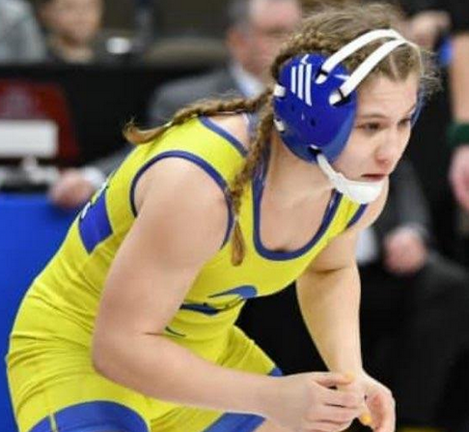
Ann Marie Meiman
Selected for Outstanding Scholarship and Achievement in the Sport of Wrestling
Academics: GPA -3.94 Rank: 6/379
10th Grade: District Champion, 5th place at State, School Record 27-6, Academic All-State
11 Grade: District Champion, 4th place at State, School Record 31-3, Academic All-State, Team Captain
12 Grade: District Champion, State Champion, School Record 41-1, planning to be on Team Nebraska’s national team -Summer 2024

Slide 24
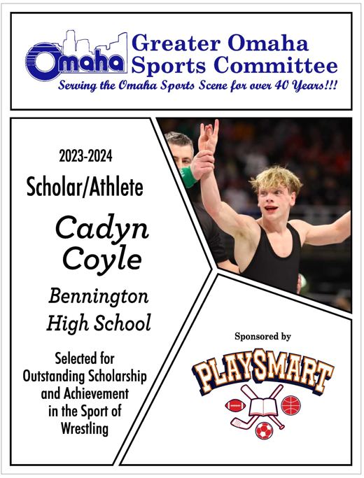

Slide 25
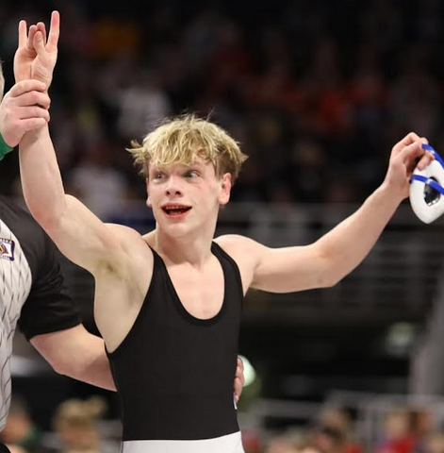

Cadyn Coyle
Selected for Outstanding Scholarship and Achievement in the Sport of Wrestling
Academics: GPA - 3.3
10th Grade: State Runner-Up, 3rd Place at Fargo Nationals
11 Grade: State Champion, Fargo National Champion, Preseason Nationals Runner Up
12 Grade: State Champion

Slide 26
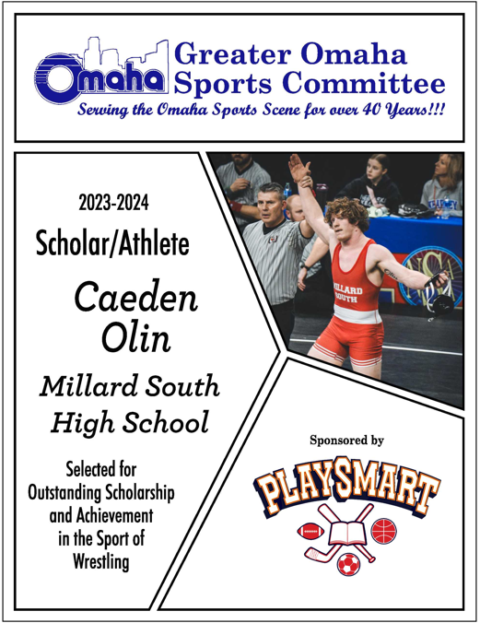

Slide 27
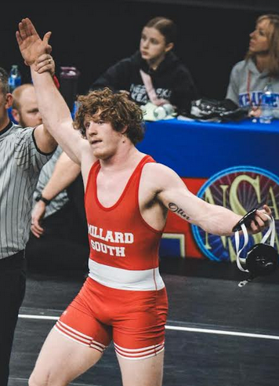
Caeden Olin
Selected for Outstanding Scholarship and Achievement in the Sport of Wrestling
Academics: GPA - 3.7
10th Grade: 2nd at State (182), Metro Champion (182)
11 Grade: State Champion (195), Metro Champion (195), nationally ranked top 20 (195)
12 Grade: State Champion (215), Cheesehead Invite Champion (215), Metro Champion (215), nationally ranked top 25 (215)

